Slide 1
ONLINNE TEST MANAGEMET SYSTEM
By
Samayamanthula Sri Harsha
Syed Waseem Fahad
Mandapati Mahathi
Sivaramakrishnan Thiruvengadam

Slide 2
OBJECTIVE
To develop an Online Test Management System with various roles for admin and user like the user can take a test when it is assigned by the admin after registering and also check the results when declared. Where as for the admin, he/she can assign a test to particular users and can create a new test, update the existing test by either updating the questions or by deleting them and can also delete the entire test.

Slide 3
TECHNOLOGIES
Angular -8
HTML-5 & CSS-3
Java -1.8
Spring Boot -2.3.3
Maven -4.0.0
Hibernate -5.2.1
Oracle -11g

Slide 4
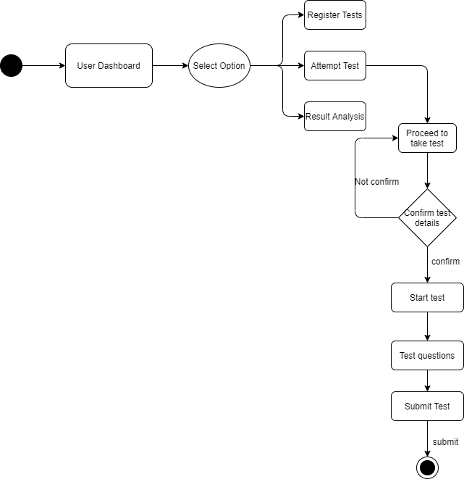
USER SERVICE

Slide 5
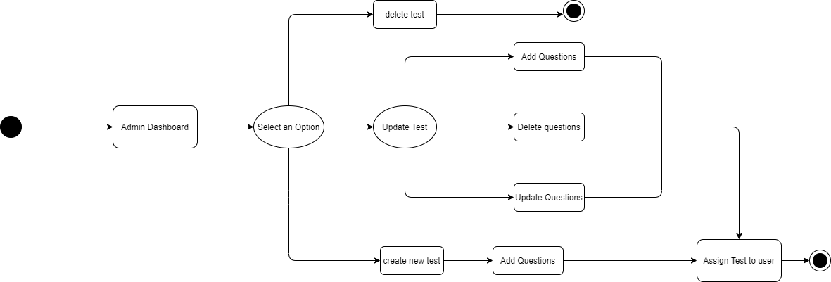
ADMIN SERVICE

Slide 6
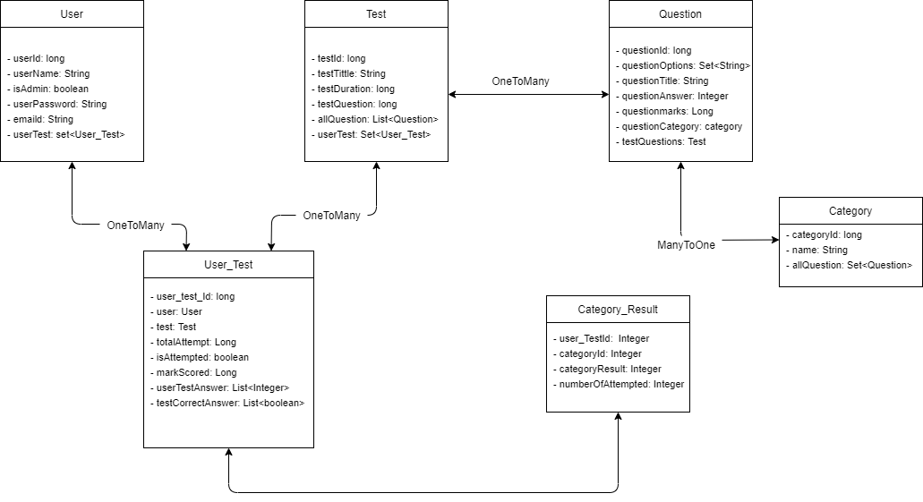
ENTITY DIAGRAM

Slide 7
OUT OF SCOPE
This system does not contain theory tests and questions in it.
It only contains multiple choice questions in which only one option can be selected by the user.

Slide 8
THANK YOU

